Slide 1

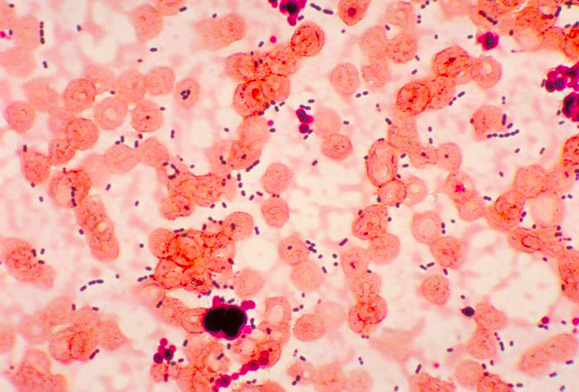
Enterococcal Septicemia and Outcomes
Bracha Robinson, MD; Premal Patel, MD; Jagan Mohan Rao Vanjarapu, MD; Michael Rothberg, MD; Pramil Cheriyath, MD, Vinod Nookala, MD
Department of Internal Medicine, Hackensack Meridian Health Ocean Medical Center, Brick NJ
Background/Purpose:
RESULTS
Enterococcal Bacteremia third most common nosocomial infection in the united states and associated with higher mortality.
Enterococcal bacteremia results in a very high mortality and it usually exists with other facultative and anaerobic organisms.
To date, most of the studies have used ICD-9 CM codes while looking for the outcomes among the patients with Enterococcal Bacteremia.
Our objective of the study is to discuss the outcomes of Enterococcal Bacteremia using ICD-10 CM codes from the most recent national database
Figure 2: Bar chart showing racial distribution in the study population
There was a total of 75,430 patients included in the study who developed enterococcal bacteremia.
In this cohort, 44,270 were males and 31,160 females. Caucasians and African Americans were more predominant in the study population.
Renal failure and congestive heart failure were the most common underlying co-morbidities.
In-hospital mortality is 11.07%, which was most likely due to the underlying co-morbidities, with an average length of stay of 13.8 (5-15) days and economic burden 41,232.6 (11,296.9 - 37,824.3) USD.
Age-adjusted mortality among patients with enterococcal sepsis is 3.17 (3.09-3.25)
Figure 4: Pie chart showing various co-morbidities among the study population
METHODS
We conducted a retrospective cohort study using a publicly accessible National Inpatient Sample (NIS) database from October 2015 to December 2017.
NIS database developed through a Federal-State-Industry partnership sponsored by the Agency for Healthcare Research and Quality (AHRQ), HCUP data inform decision making at the national, State, and community levels.
Adult patients (>18), who developed enterococcal bacteremia were included in the study.
Figure 5: Bar diagram showing in-hospital mortality in patients with enterococcal septicemia
Enterococcal Infection
Demographics | Number of Patients | Comorbidities | Number of Patients (%)
Male | 44,270 | CHF | 25.90%
Female | 31,160 | Valvular Disease | 8.10%
Caucasians | 50,270 | Neurological Disease | 11.90%
African-American | 11,210 | DM with complications | 18.90%
Native American | 2,025 | Renal Failure | 28.50%
Hispanic | 6,445 | Obesity | 11.60%
Figure 6: Bar diagram showing the average length of stay for patients with enterococcal septicemia
Conclusion
Based on the results from our study, we found that patients with enterococcus bacteremia have statistically significant higher in-hospital mortality, prolonged length of stay and higher economic burden.
Figure 1: photomicrograph shows cocci shaped enterococcal bacteria; Courtesy: Varman et al.
Figure 3: Table showing gender, racial distribution and underlying comorbidities in the study population

